Slide 1
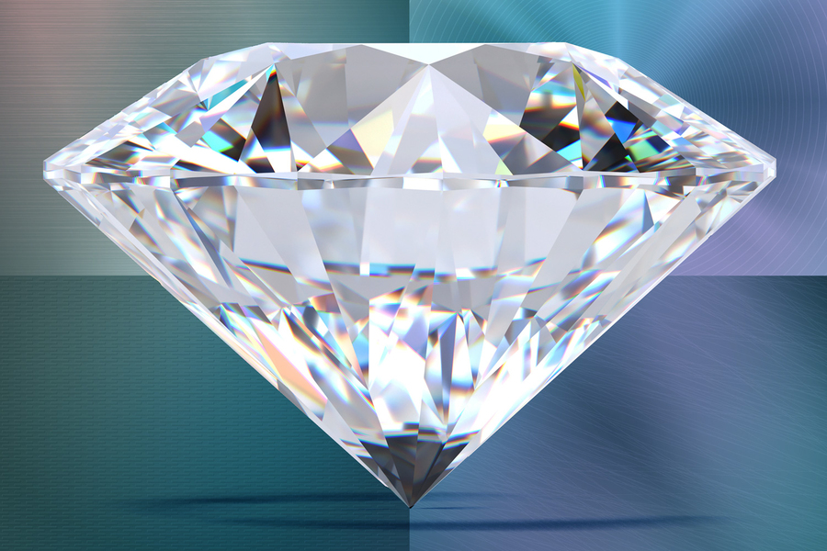
Diamond Vendor Data Analysis and Visualization
Vamshi Gadepally & Vivian Yeh
December 02, 2022

Slide 2
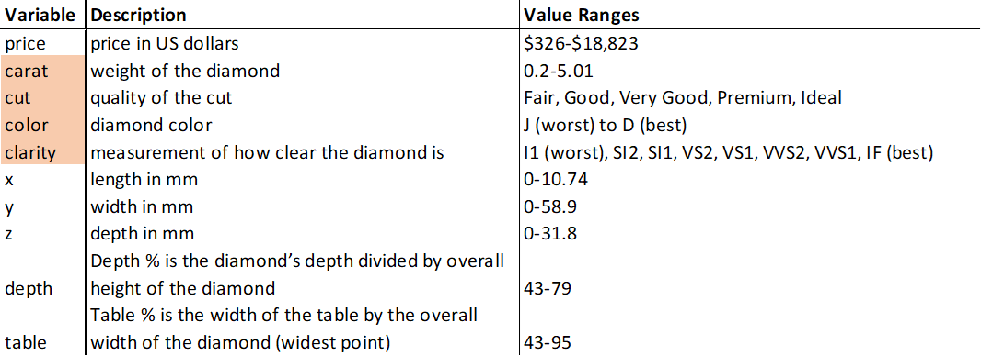
Data Description
We are working with a dataset with Prices and Attributes of approximately 54,000 round-cut Diamonds.
Data Source: https://data.world/nahrin/diamonds

Slide 3
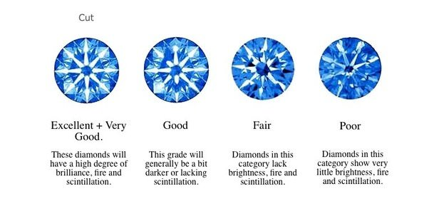
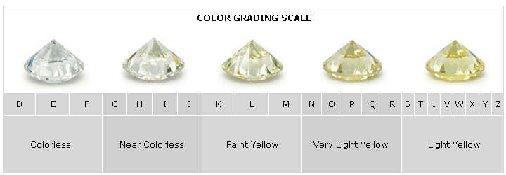
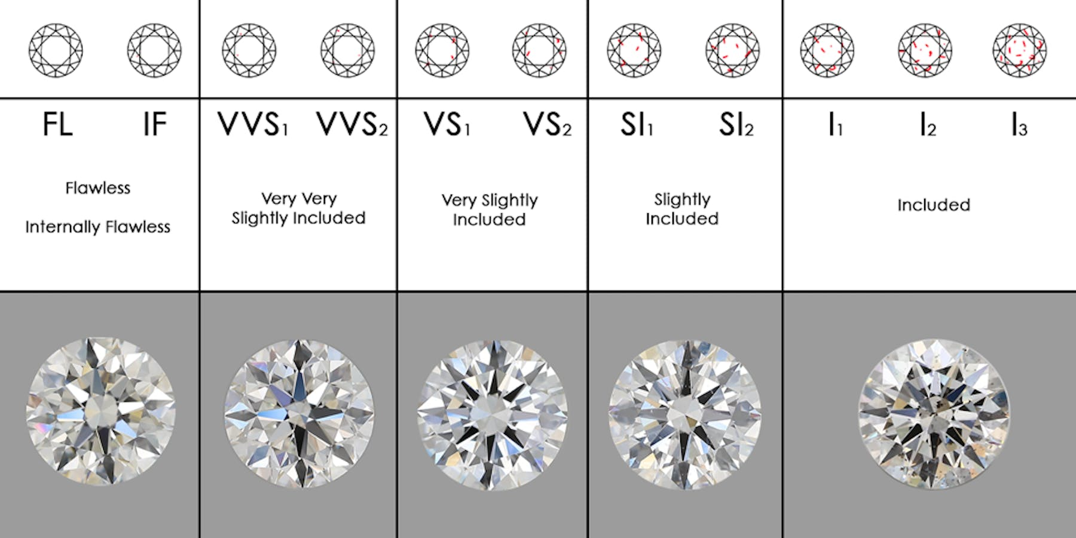
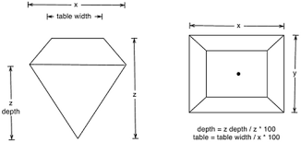
Data Description
Notes:
The better a diamond has been cut, the greater the diamond’s ability to reflect and refract light.
Diamonds with an N to Z color rating are usually not used in jewelry.
Diamond clarity refers to the purity and rarity of the stone, and the degree to which it presents blemishes and inclusions.
While clarity has a significant effect on the value of a diamond, most defects are invisible to the naked or unassisted eye.

Slide 4
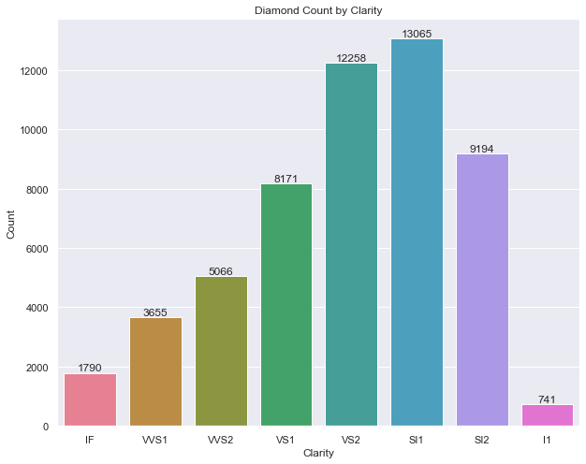
Distribution Graph - Clarity
Clarity Order: “IF” (best/flawless) to “I1” (worst/included)
Clarity depends on diamond availability and demand
The lower mid-range Clarity types, “VS2” and “SI1” appear to satisfy both availability and demand more than the other types

Slide 5
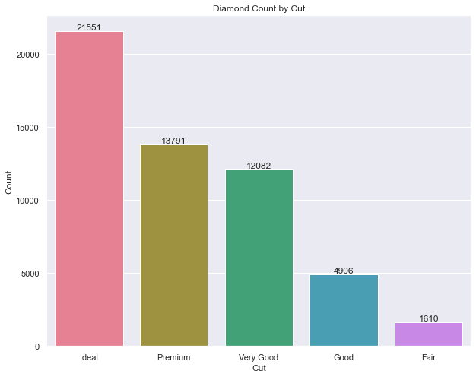
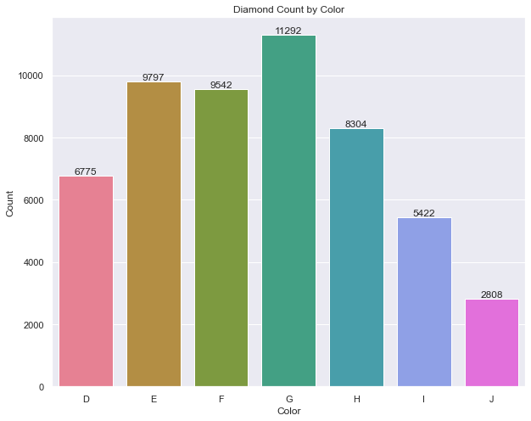
Distribution Graph - Cut and Color
Notes:
Cut
Cut Order: Ideal (best) to Fair (worst)
Cut is not a natural factor, and is done in labs so it makes sense that the best cut has the highest count, and vice versa.
Masterfully crafted facets create incredible displays of light and make the diamond appear larger than it actually is.
Color
Color Order: D (best/colorless) to J (worst/near colorless)
Rarity and quality – completely colorless diamonds are the rarest, which makes them valuable.
Most of the diamonds in this diamond supply have a color in the higher mid-range color scale.

Slide 6
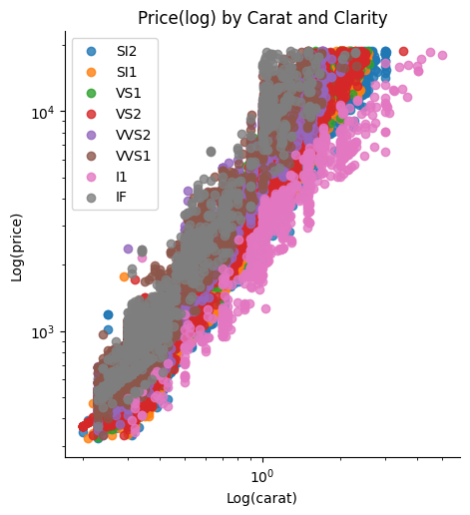
Log(10) Price vs Carat Scatter Plot by Clarity
Holding carat constant
Most expensive: Clarity “IF”
Least expensive: Clarity “I1”
Clarity explains the variance found in Price well – lower clarity, less expensive; higher clarity, more expensive
Notes:
Carat or a diamond's weight is a big factor in determining the diamond's price. Holding carat constant here, we can explore the other factors that influence the price of a diamond.

Slide 7
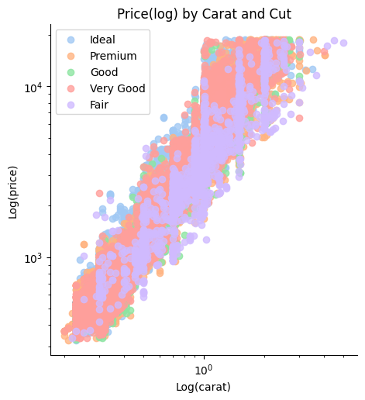
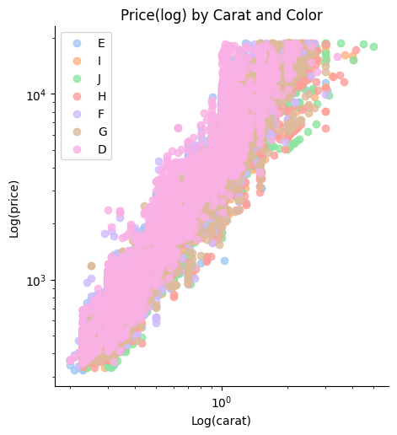
Log(10) Price vs Carat Scatter Plot by Cut and Color
Notes:
Still holding Carat constant.
Carat and Cut
Generally, the “ideal” cuts stand out on top and the “fair” cuts lie on the lowest end.
However, there are overlaps between the categories. For example, the “very good” cuts spread out almost everywhere.
Division between these categories are not as clear as it was for clarity.
Carat and Color
Clear division and clear influence on price.
The colorless diamonds (D, E, F) have higher prices, whereas the near colorless diamonds (G, H, I, J) have lower prices.

Slide 8
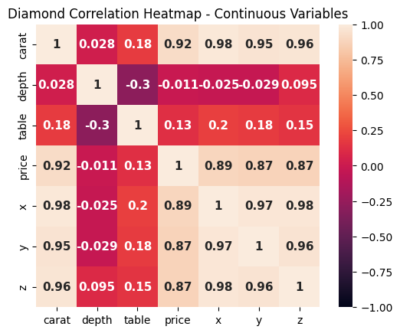
Correlation Heatmap
Notes:
As expected the correlation between the Carat and Price is relatively high at 0.92.
Interestingly, depth is not strongly correlated with price at all and, in fact, is somewhat negatively correlated.
We can also learn that the strongest relations are among the X, Y, and Z features. They all have >0.8 correlation.

Slide 9
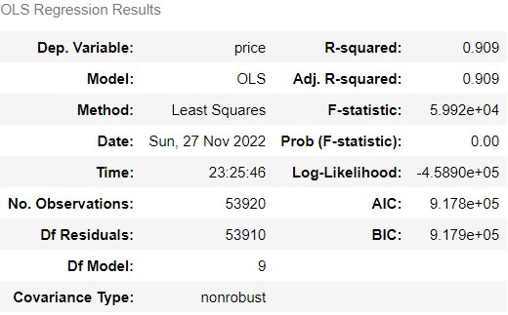
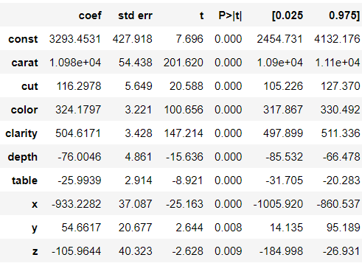
Linear Regression Model
We investigated the effect of a Diamond’s properties on its Price and developed a Linear Model to decide the Price dependence on these factors.
Notes:
The Regression Model with all the parameters accounts for 91% of the response variable variance (Price).
We’re implement Ordinary Least Squares(OLS) method of linear regression here.

Slide 10
Linear Model Interpretation
As we can see from the linear regression that the p-values are all < .05 so all are significant predictive variables.
We can observe that the effect of Carat (Weight) on the Price is much higher than that of other variables.
As the Weight increases, the Price increases a significant amount ($10978.27 per carat increase).
Some factors heavily decrease the Price when they are increased, for example Depth, table X and Z-Length.
The X-Length heavily decreases the Price relative to other negative contributing factors.
The Table offers low decrement on Price.
The Clarity offers a decent increment in Price when it is increased but less than that of the weight’s (Carat) effect.
The Color, Cut and Y-Length offer minute positive effect on the Price.

Slide 11
Summary
Our study is to find of different factors contribute in deciding the Price of a Diamond.
It's well known that a Diamonds weight or carat is a big factor to determine the Diamonds Price however as we can see it doesn’t explain for all of the variation in Diamond Price.
While the Price of a Diamond could be explained by more than just the 4Cs (Cut, Color, Clarity and Carat) of the Diamond, each of the 4Cs do have a positive impact on the price but don’t have an equal importance on price.
Carat has the largest impact on price among the 4Cs, while keeping everything else constant, followed by Clarity and Color of the Diamond.

